Slide 1
Component Baseline Analysis
Introductory Webinar

Slide 2

Component Baseline Analysis
What is it?
Who takes it?
How do you administer the survey?
How do I get/use my data?
Notes:
What is it?
Perception Survey
Who takes it?
All Certified Staff/Administrators
How do you administer the survey?
Via a Qualtrics Link (Preview Items)
How do I get my data?
Email accreditation@ksde.org

Slide 3
Misconceptions- Clearing the Air
Is the CBA required?
NO!
It’s one tool you can use to gather staff perception on the system.
Is the CBA a needs assessment?
NO!
It’s one part of a comprehensive needs assessment, but it is not the whole thing.

Slide 4
What is it?
Perception Survey
  Created by: KSDE, MTSS, and ESC Leaders
6 Evaluated Areas: (Items)
  State Board Outcomes
  Foundational Structures
  Leadership & Culture
  Curriculum, Instruction, and Assessment
  Data-Based Decision Making
  Design Principles
    Student Success Skills, Personalized Learning, Family/Business/Community Partnerships, and Real World Application

Slide 5
Who takes the survey?
Recommended
Consider
Administrators
Certified Staff
Classified Staff
  Human Resources
  Special Services
Paraprofessionals
Teacher Aides
Food Service
Maintenance

Slide 6
How do you administer the survey?
Introduce the Survey to Staff
  Purpose
  Content
  Location Selection
  Email Sample
Establish a Window for Survey Completion
Share Link with Directions for Survey Completion
1-Take/User
Survey Link (PUBLIC): https://ksde.sjc1.qualtrics.com/jfe/form/SV_8xpd1EvGBi7mMM6
Survey Link (PRIVATE): https://ksde.sjc1.qualtrics.com/jfe/form/SV_3eGxbpZ9MgINtZQ
Notes:
Guidance - https://www.ksde.org/Portals/0/TLA/Accreditation/CBA%20Guidance.pdf?ver=2022-08-25-083127-637
DO NOT WRITE ON THE PDF ITEM VIEW; YOU MUST TAKE THE SURVEY VIA QUALTRICS
If you have staff who work at more than one building, our recommendation is that they complete the survey for the location in which they receive their annual evaluation. So if one building does that over another, choose that building; if the district does the evaluation, then they should answer as a district level user.

Slide 7
How do I get my data?
Options:
1 Aggregate Report (Sample)
  District Level
  Building Level
+
Building-Level
Individual Buildings
Email accreditation@ksde.org
Expect a 3-5 Business Day Turn-Around
Sarah Perryman (sperryman@ksde.org)
Ann Yates (ayates@ksde.org)

Slide 8
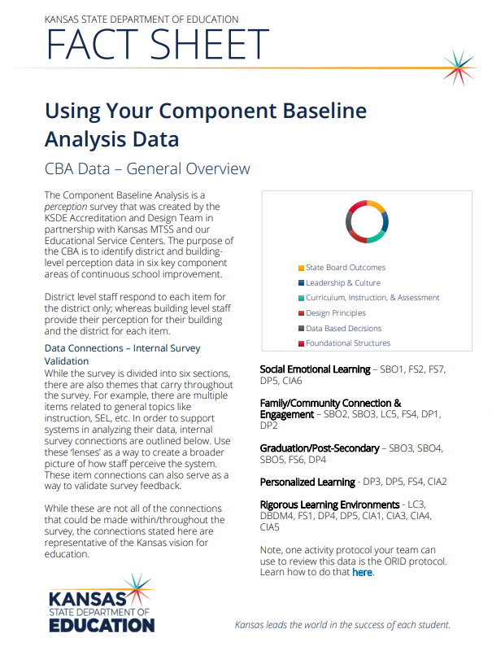
How do I use my data?
Use Items Across Components to Validate Responses
  Extrapolate Larger Themes
Buildings can use this to inform their Legislated Building Needs Assessment
Compare to Quantitative Data to Determine Trends & Goals
  Data Analysis Action Steps
Notes:
CBA Results Guidance - https://www.ksde.org/Portals/0/TLA/Accreditation/CBA%20Results%20Guidance.pdf?ver=2022-08-25-083127-637

Slide 9
Resources
CBA Administration Guidance
CBA Results Guidance
CBA Introductory Email Template
CBA Item Preview

Slide 10
Q & A

Slide 11
accreditation@ksde.org
Sarah Perryman, Coordinator of Accreditation and Design
sperryman@ksde.org
785-296-1074

